Slide 1

WELCOME TO MY PRESENTATION

Slide 2
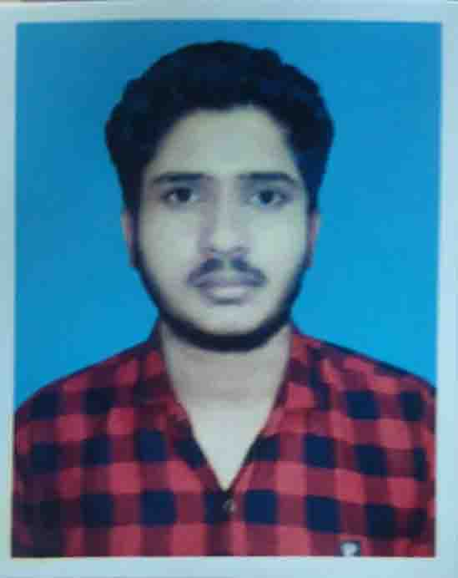



MD.ABUL BASAR
Mobile:01875576476
Email:mdabulbasarbasar025@gmail.com
Patuakhali , Narsingdi

Slide 3
OBJECTIVE:
Seeking innovation and challenging career in a growing organization which gives me an opportunity to utilize my skills & knowledge and provides me an opportunity for career growth.
Academic Profile:
Starting B.SC. Engg. in Computer science And Engineering From 2022
University: Patuakhali science And Technology
Intermediate HSC from Narsingdi Govt. College in 2021
Secondary from Goyespur P.L. High School in 2019

Slide 4
Personal Information:
Father’s Name : Tajul Islam
Mother’s Name : Karima Begum
Gender : Male
Marital Status : Unmarried
Nationality : Bangladeshi
Hobbies : Reading Books
Adress : Palash, Narsingdi, Dhaka

Slide 5
SKILLS
Programming
Adobe Photoshop
MS Excel
MS WORD
AutoCAD
Ms Power Point
Scratch programming
Ms Visio

Slide 6
LANGUAGE
English
Bangla
Hindi
Arabic

Slide 7
EXTRACURRICULAR ACTIVITIES
Playing Cricket
General member of Bhadon
Volunteer of CSE Club
SKILLS ENHANCEMENT TRAINING:
Training title: Graphics Design
Duration: 1 Month
Institution: Pentanic IT

Slide 8
Declaration:
All the above information is correct up to my knowledge and I bear the responsibility of the correctness.

Slide 9
THANK YOU!!!

